Slide 1

Neonatal Bilirubin Encephalopathy
Marissa D’Souza

Slide 2
1.
Hyperbilirubinemia

Slide 3
Bilirubin Metabolism
Breakdown of heme
Very poorly soluble before conjugation
Conjugated via liver glucuronyl transferase before being excreted
Bound to albumin
Notes:
Oral administration of charcoal, agar, or cholestyramine may interfere with the absorption of unconjugated bilirubin, thereby increasing the efficacy of phototherapy.

Slide 4
2%
2-10%
0.001%
~ Incidence of severe hyperbilirubinemia ( > 20 mg/dL)
Risk for ABE in those with severe hyperbilirubinemia
Overall incidence of CBE/ kernicterus

Slide 5
Risk Factors for Hyperbilirubinemia in Full-Term Newborns
Jaundice within first 24 hours after birth
A sibling who was jaundiced as a neonate
Unrecognized hemolysis (ABO, Rh blood type incompatibility)
Non-optimal sucking/nursing
Deficiency in glucose-6-phosphate dehydrogenase (G6PD)
Infection
Cephalohematomas/bruising
East Asian or Mediterranean descent
Notes:
Jaundice within first 24 hours after birth
A sibling who was jaundiced as a neonate
Unrecognized hemolysis (ABO, Rh blood type incompatibility)
Non-optimal sucking/nursing
Deficiency in glucose-6-phosphate dehydrogenase
Infection
Cephalohematomas/bruising.
East Asian or Mediterranean descent

Slide 6
2.
Bilirubin-Induced Neurologic Dysfunction (BIND)
Acute Bilirubin Encephalopathy
Notes:
MOA unknown but

Slide 7
Bilirubin Encephalopathy - Pathophysiology
↑ lipophilic, unbound, unconjugated bilirubin
Crosses the BBB
Deposition in the basal ganglia and brainstem nuclei of the brain resulting in neuronal injury
Pathogenesis regarding how exactly bilirubin damages the brain = ?
May involve lipid peroxidation, neuroinflammation, and excitotoxicity
Notes:
Deposits in the:
1) globus pallidus, 2) sub-thalamic nuclei, 3) hippocampus 4) oculomotor nuclei, 5) ventral cochlear nuclei
KSD typically spares the cortex and, interestingly, the striatum and thalamus

Slide 8
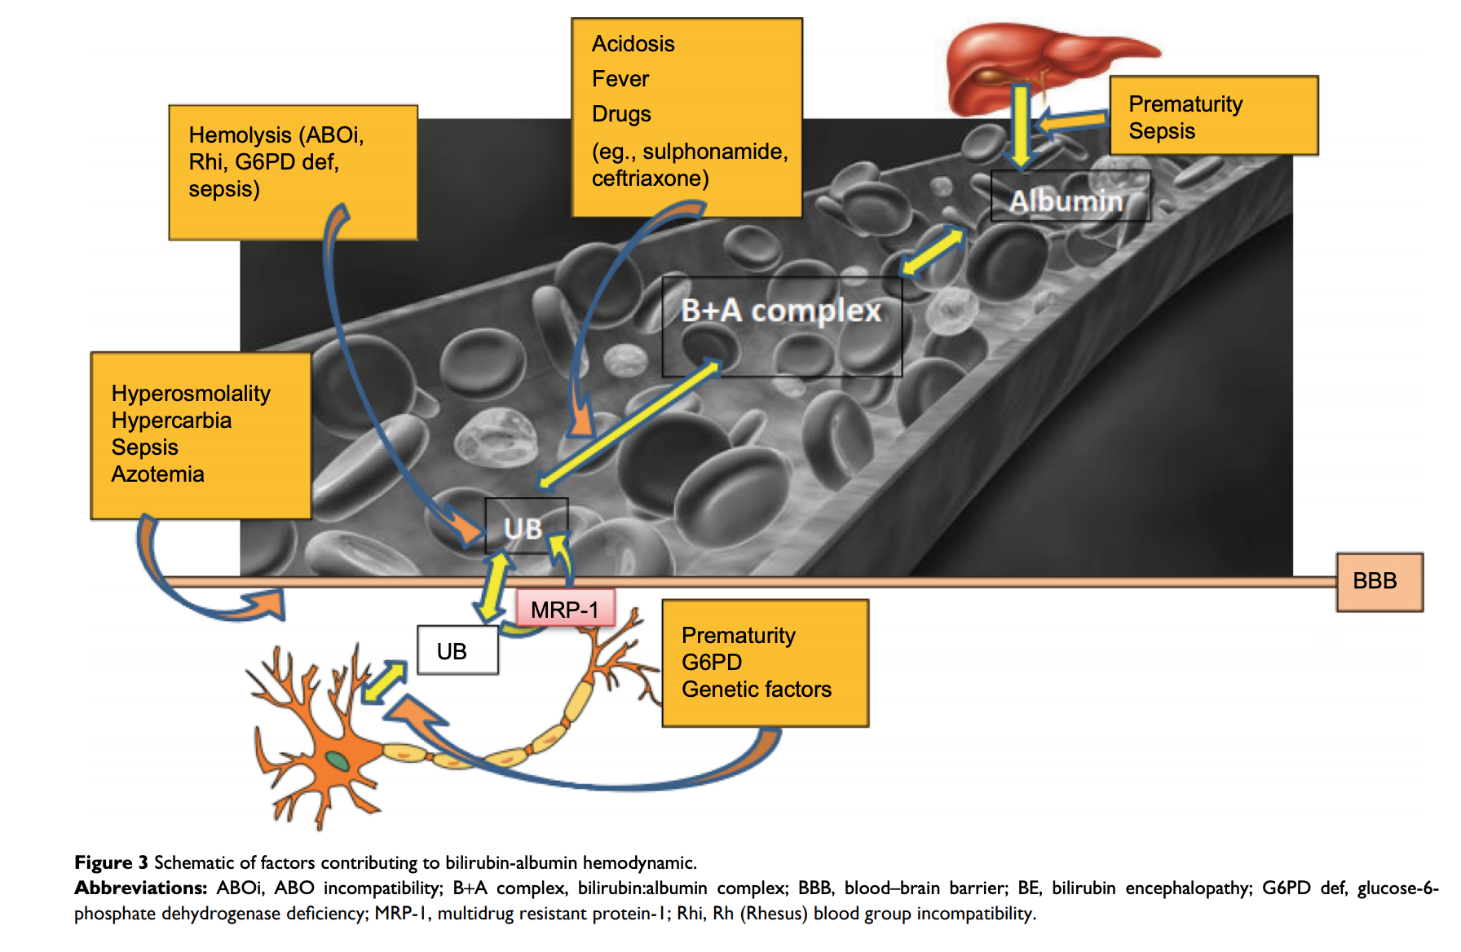
Bilirubin Encephalopathy – Basic Mechanisms
↑ bilirubin
↓ albumin-binding capacity
↑ bilirubin into the brain
↑ permeability
↑ blood flow
↓ albumin
↓ albumin-binding sites
↑ production
↓ excretion
Notes:
Sulfonamides - due to displacement of bilirubin from its binding site with albumin by sulfonamides
Hyperosmolality (as seen in hyperglycemia, hypernatremia and azotemia), hypoxia and asphyxia affect the integrity of the BBB leading to prolonged exposure of the brain to bilirubin (Figure 3).
Hemolysis increases the risk of BE mainly due to the rapid increase in bilirubin production

Slide 9
Acute Bilirubin Encephalopathy
≠ kernicterus
Chronic Bilirubin Encephalopathy
= kernicterus

Slide 10
Acute Bilirubin Encephalopathy – Epidemiology
Defined as the acute manifestations of kernicterus
Incidence is unknown; some studies suggest 1/100,000
Notes:
Kernicterus is used interchangable with both ABE but should be used to refer to CBE

Slide 11
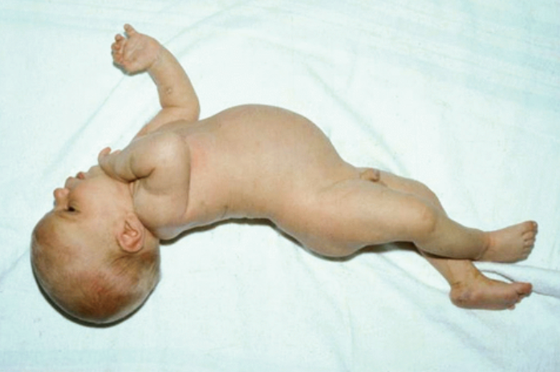
Acute Bilirubin Encephalopathy – Clinical features
Early phase:
Lethargy, hypotonia, poor suck
Intermediate phase:
Moderate stupor, hypertonia, irritability
Backward arching of the neck and back (retrocollis, opisthotonus)
Late phase: after the first week
Loss of hypertonia, muscle rigidity, paralysis of upward gaze, irregular respirations
Mortality → 21%
Notes:
Kernicterus is used interchangable with both ABE but should be used to refer to CBE

Slide 12
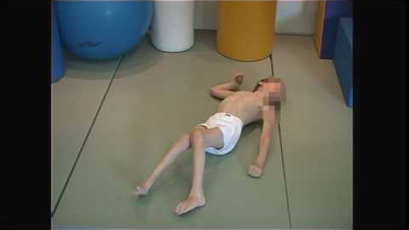
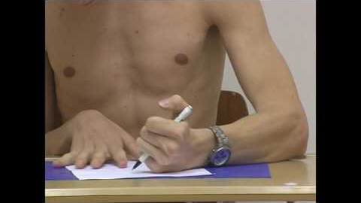
Acute Bilirubin Encephalopathy – Clinical features
Athetoid (dyskinetic)
Dystonic

Slide 13
Acute Bilirubin Encephalopathy – Clinical features
Dental enamel hypoplasia
Gaze paralysis

Slide 14
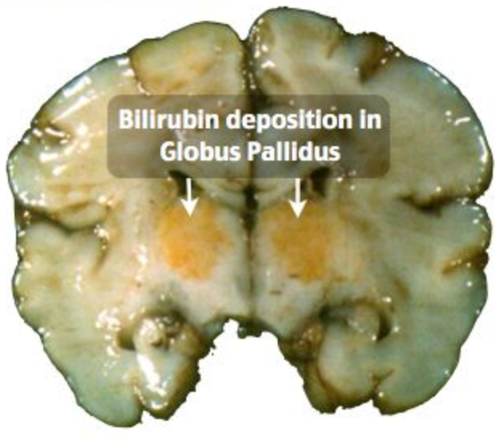
Acute Bilirubin Encephalopathy – Clinical features

Slide 15
Chronic Bilirubin Encephalopathy = kernicterus
Defined as the chronic and permanent post-icteric sequelae of extreme hyperbilirubinemia
Classic kernicterus –
Auditory neuropathy/hearing loss (auditory nuclei)
Neuromotor like dystonia, hypertonia, athetosis (basal ganglia)
Oculomotor paresis of upward gaze (oculumotor nuclei)
Enamel dysplasia of deciduous teeth
Auditory kernicterus
Motor kernicterus
Subtle kernicterus or bilirubin-induced neurologic dysfunction (BIND)

Slide 16
3.
Prevention and Treatment
Notes:
MOA unknown but

Slide 17
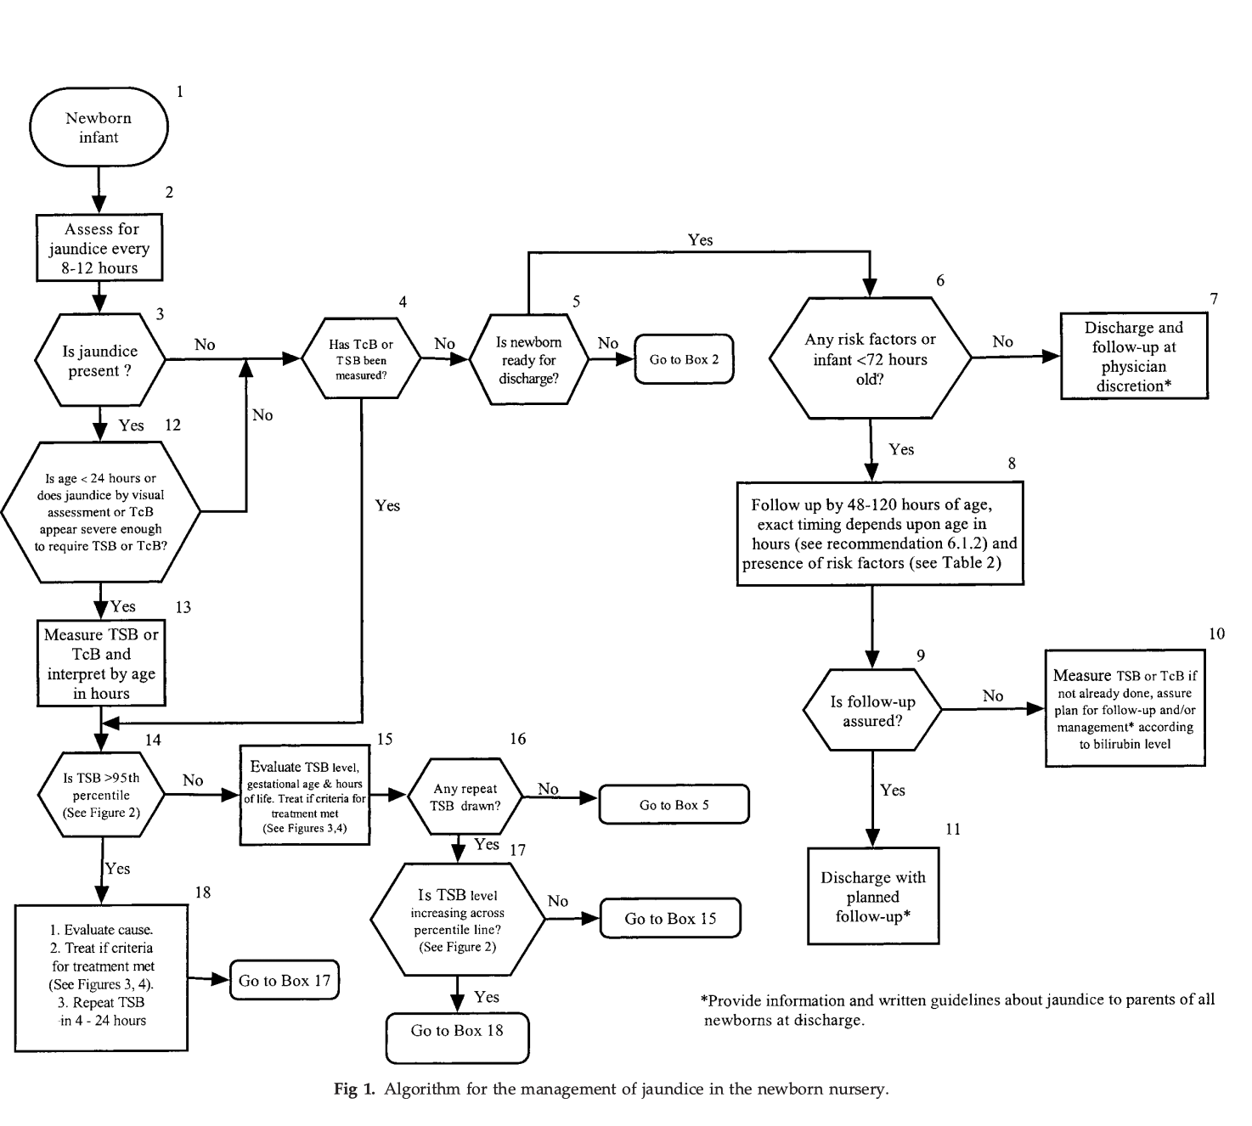
AAP Algorithm and Guidelines
The primary goal is to prevent neonatal kernicterus.
Some have suggested that this is a “never-event.”

Slide 18
39w6d male with G6PD has TB of 13 mg/dL at 36h → start phototherapy?

Slide 19
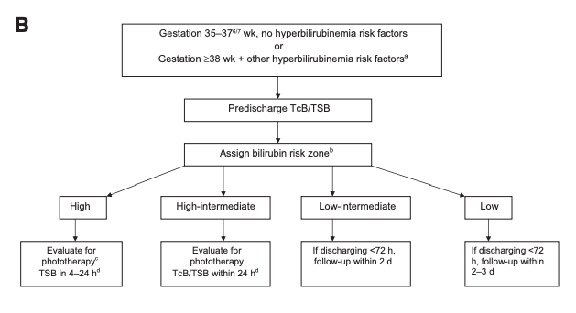
1) Determine risk group (eg, high, medium, low)
39w6d male with G6PD and TB of 13 mg/dL at 36h

Slide 20
2) Determine risk zone (eg, low, low intermediate, high intermediate, high)
39w6d male with G6PD and TB of 13 mg/dL at 36h
High Risk

Slide 21
39w6d male with G6PD and TB of 13 mg/dL at 36h

Slide 22
Bili obtained 12 hours later is 11.5 mg/dL

Slide 23
3) Determine if need for phototherapy
39w6d male with G6PD and TB of 11.5 mg/dL at 48h
Do not treat
Notes:
24 hour old wihth bili of 12 + risk factor + 39 weeks

Slide 24
Treatment
Phototherapy lights
Sunlight is not recommended as a safe way to reduce bilirubin levels.
↑ milk intake
Feed by NG tube for the somnolent infant
Lactation counseling
Exchange transfusion may be recommended
Determine the underlying cause of jaundice

Slide 25
Prevention
Nurse infants at least 8-12x/d for the first several days
Test for prenatal ABO and Rh(D) blood types
Evaluate for jaundice whenever getting vitals but no less than q8-12h
BiliTool
Measure albumin and consider ↓ phototherapy threshold (D)

Slide 26
Questions?

